Slide 1
Classification of Acoustic Scenes
Gregory Miles
Kevin Parton
Raymond Wu

Slide 2
Hypothesis
It is possible to classify a recording into predefined classes by using audio waveform calculations.
We will be using the following classes:
Bus
Café/Restaurant
Car
City Center
Forest Path
Grocery Store
Home
Lakeside Beach
Library
Metro Station
Office
Residential Area
Train
Tram
Urban Park

Slide 3
Method Overview
Using sample audio files provided by IEEE AASP Challenge
Determine Mel-Frequency Cepstrum Coefficients (MFCCs) of an audio file
Use machine learning and statistical pattern recognition to predict and classify other audio scenes

Slide 4
MFCCs
MFCCs represent short-term power spectrum of a sound
MFCCs are meant to approximate human auditory system’s response
Commonly used for voice recognition
In the course of our project we will have to discover which statistical representation (mean, median, mode, or some aggregate) is optimal

Slide 5
Current Findings
Data collected and stored using Python/MongoDB
Implemented use of an initial classification algorithm
Visualization of those initial results

Slide 6
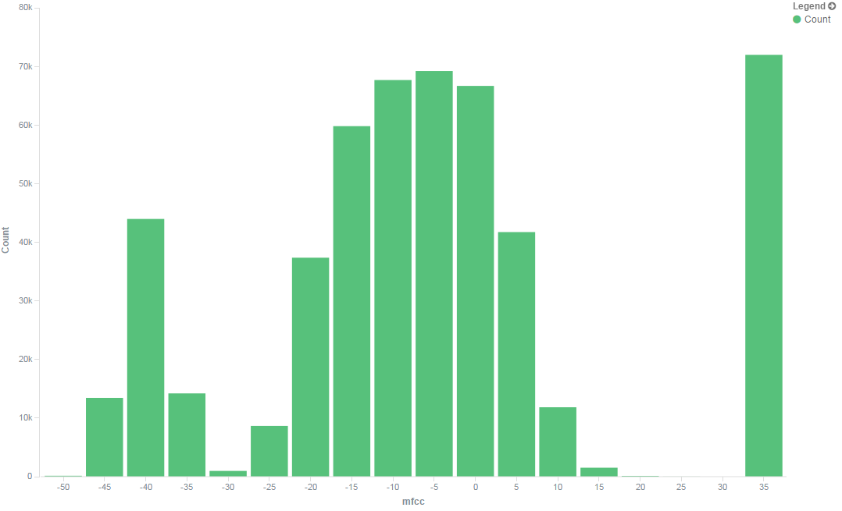
Current Findings
Notes:
This is a sample finding of just one of the scenes (bus)

Slide 7
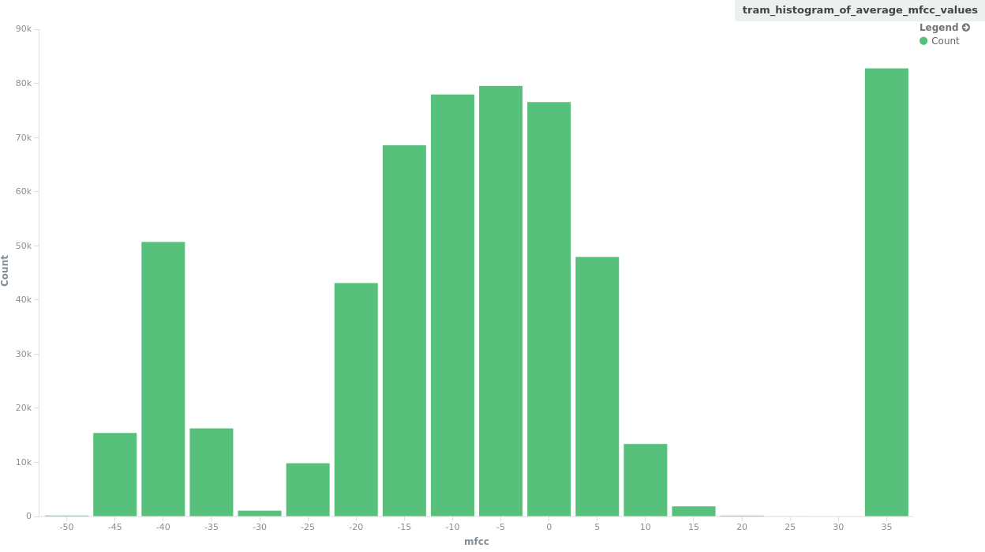
Current Findings
Notes:
This is a sample finding of just one of the scenes (tram)

Slide 8
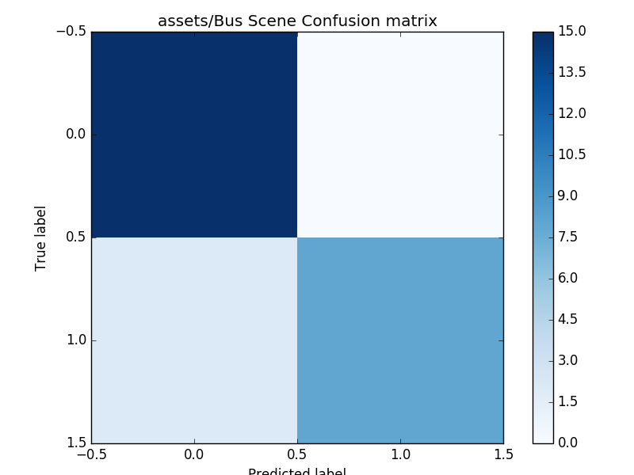
Example Confusion Matrix from Support Vector Machine Results
Effective ness of classifier
Lower right: True positive
Upper left: true negative
Upper right: false positive,
Lower left: false negative

Slide 9
The Future
IEEE AASP Challenge also provides a second large set of audio files to test solutions
Continuously document and improve accuracy

